Slide 1
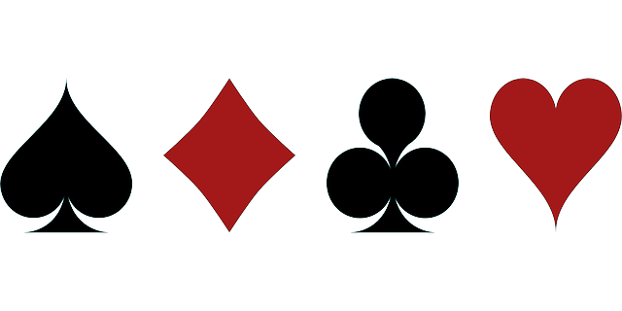
KILLER CUTTHROAT SPADES
CS6316.001 P04
SPRINT 3 REVIEW MEETING
TEAM: 10

Slide 2
INDEX
Product Backlog Updated Product Backlog
Sprint Backlog Current Sprint Backlog
Task Board TaskBoard
Sprint Burndown Chart
Lessons learnt in this sprint.

Slide 3
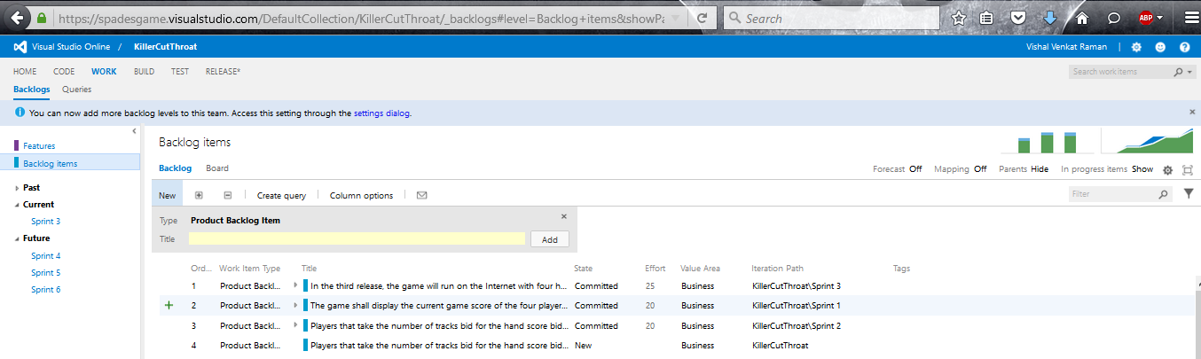
PRODUCT BACKLOG
The undone user-stories of the sprint 3 are projected on the backlog.

Slide 4
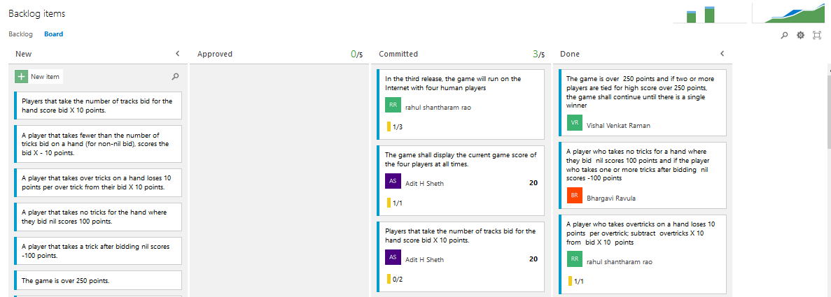
PRODUCT BACKLOG

Slide 5
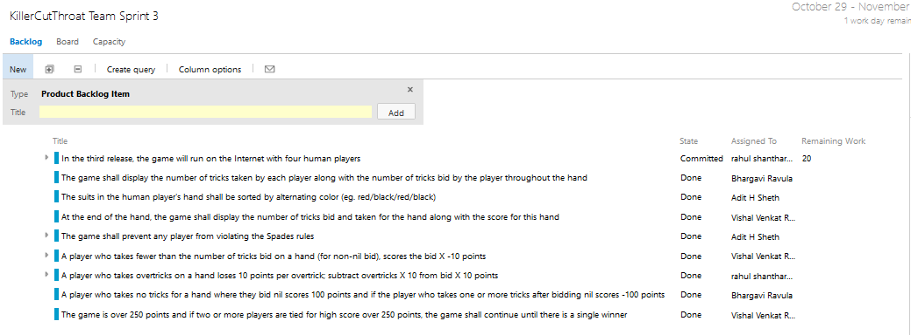
SPRINT BACKLOG

Slide 6
TECH STORIES
We’ve used Visual Studio Online(upgraded version of Team foundation Server). It is set of complementary cloud based services to helps a team write code better. It provides agile project management tools, build services, code, test and deploy.
We’ve used the Scrum development template for the project which allowed our team to effectively keep track of the user stories in the current sprint by maintaining product backlog, sprint backlog, task board and measure the progress using sprint burn down chart.

Slide 7
TECH STORIES
Image mapping techniques have been used on a series of images in an array so as to use the right image to display for the pictures of players by specifying the right pixel range while implementing the individual image.

Slide 8
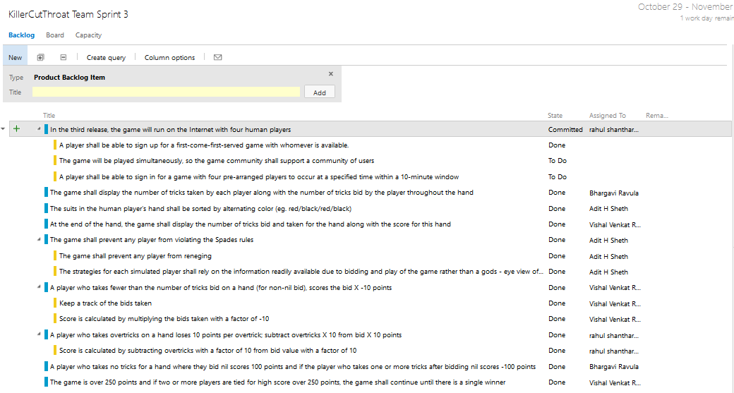
TASK BOARD

Slide 9
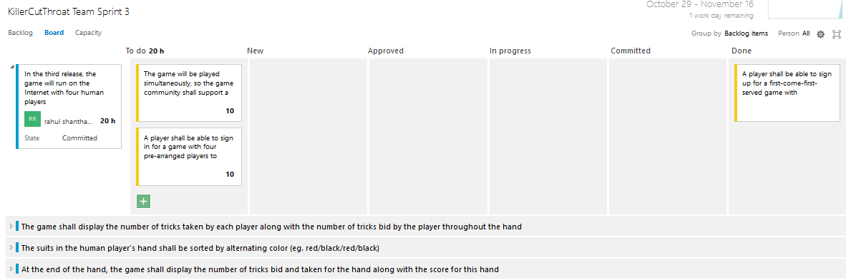
TASK BOARD

Slide 10
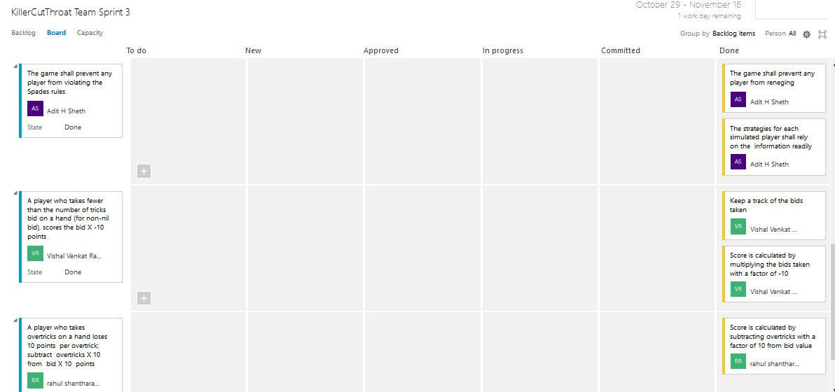
TASK BOARD

Slide 11
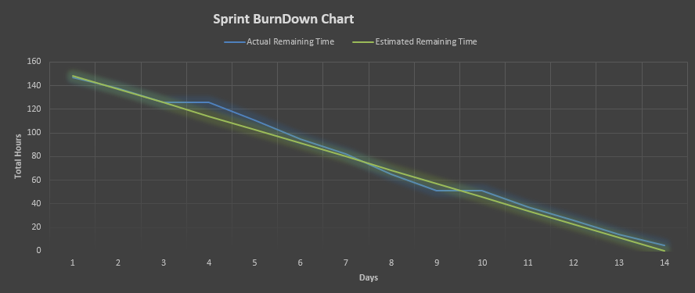
SPRINT BURNDOWN CHART

Slide 12
TEST CASES
SCENARIO | TEST STEP | EXPECTED RESULT | ACTUAL OUTCOME
Game is having 4 human players. | To join and sign up for game on internet. | Four players are selected on first-come-first-serve basis after signing up and they can play the game. | Four different players are able to play the game.
Suits in player’s hand are sorted by alternating color. | The human player’s cards are shown and sorted based on the alternating color of suits. | The cards are sorted according to alternating suit color i.e. Red-Black-Red-Black. | Sorted cards are displayed.

Slide 13
TEST CASES
SCENARIO | TEST STEP | EXPECTED RESULT | ACTUAL OUTCOME
Prevent players to violate spades rule like reneging. | The player can not violate any spades rules while playing game. | If any player reneges then error message is generated. | Error message is displayed.
Fewer tricks and overtricks scoring. | The player is given penalty for each fewer tricks and over tricks. | The player is fined by total bid * -10 points for fewer tricks and total bid points minus bid * 10 for each overtricks. | The scoring table is displayed after bids.

Slide 14
LESSONS LEARNT IN THIS SPRINT
TDD cuts development costs. Using test driven development style increases productivity and is an unmistakable proof that the code works as intended. It also encouraged us to write quality code which is organized and neat.
Testing is integrated at the most granular level, hence it is guaranteed that unwanted code will be avoided while developing.
Since we had to write test cases for each module, it also gave us the opportunity to fully comprehend the requirements of the user.

Slide 15
LESSONS LEARNT IN THIS SPRINT
Refactoring makes it easier to identify defects and debug them since refactoring makes the source code easy to read.
High quality and easy to understand codes are always easier to use, flexible, maintain and also extends the capabilities of the application.

Slide 16

Thank You

